Slide 2
Why Medicaid Expansion?
Keeps money in your pocket
Shields you from medical debt
Removes barriers to work
Boosts our economy
Defends rural communities

Slide 3
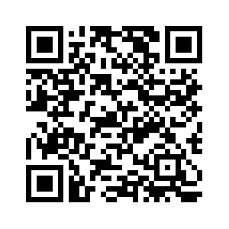
Join us for “Love Thy Neighbor” Day at the Statehouse
February 4, 2025, 10:00am
Grace Episcopal Cathedral
701 SW 8th Avenue
Topeka, KS 66603
Lunch will be provided
Scan to RSVP

Slide 4
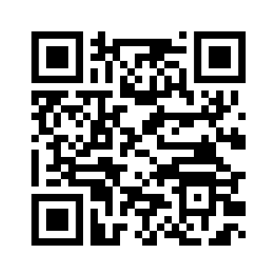
Find More Resources
County specific fact sheets
Faith-based advocacy toolkit
2025 Briefing Book on Medicaid Expansion
Topic-specific resources
…and more!
Resources from the Alliance for a Healthy Kansas

Slide 5
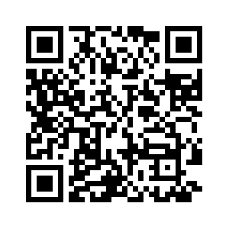
Join the Healthy Kansas Advocacy Community
A group of Kansans who want to work together to advocate for Medicaid expansion in their communities. No prior advocacy experience required!
Join the HKAC email list

